Slide 1
NAViGATE 2025 Presentation
Forget ODBC! Here’s a New Db2 Connector

Slide 2
Forget ODBC! Here’s a New Db2 Connector
Jonathan Zak and Sanjula Ganepola

Slide 3
How would you interact with DB2 from your applications?
Until now you would have to use a database client such as odbc to interact with your databases
But this is very slow…
This is likely due to the lack of native code on their client and the heavy protocol overhead

Slide 4
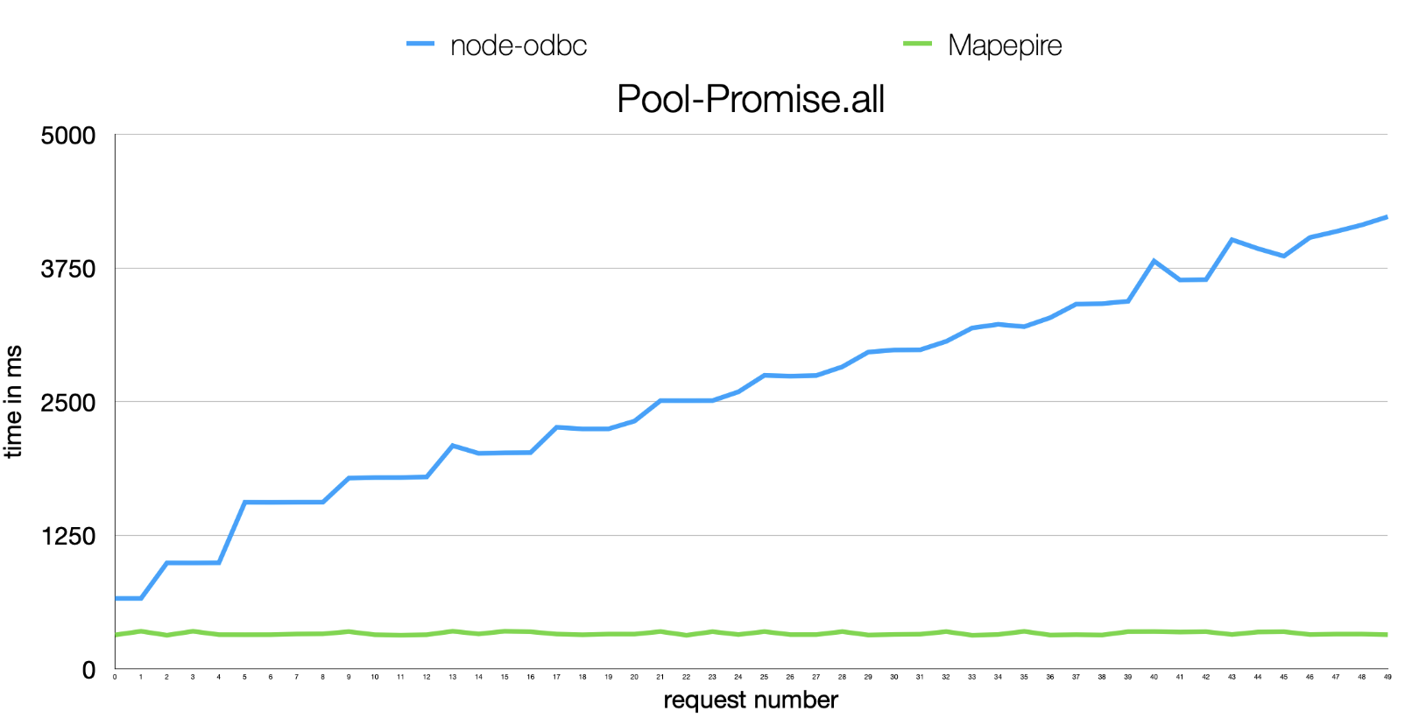
Some performance comparisons

Slide 5
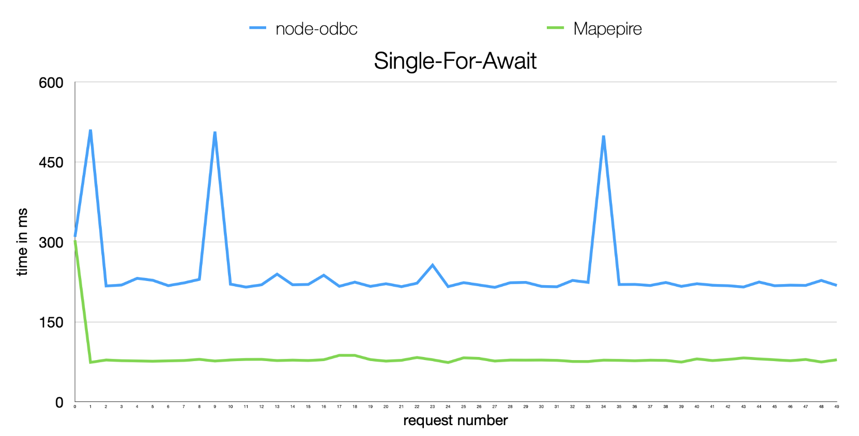
Some performance comparisons

Slide 6

Mapepire wins!
Looks like Mapepire is faster than ODBC for both executing queries with a pool, as well as executing queries individually.

Slide 7
What is Mapepire?
Back to the original question. Mapepire is a blazing fast db2 client that interacts with a server component running on the IBM i. It was built to make developing modern applications in Python, Node.js, Java , and the likes easier when using Db2 for i.
https://mapepire-ibmi.github.io/

Slide 8
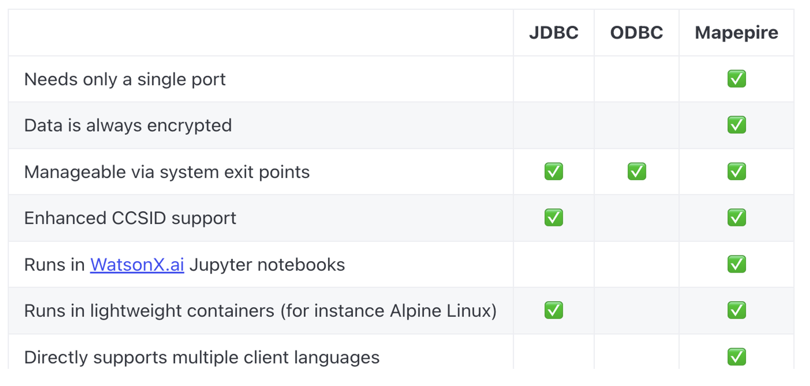
JDBC vs ODBC vs MAPEPIRE

Slide 9
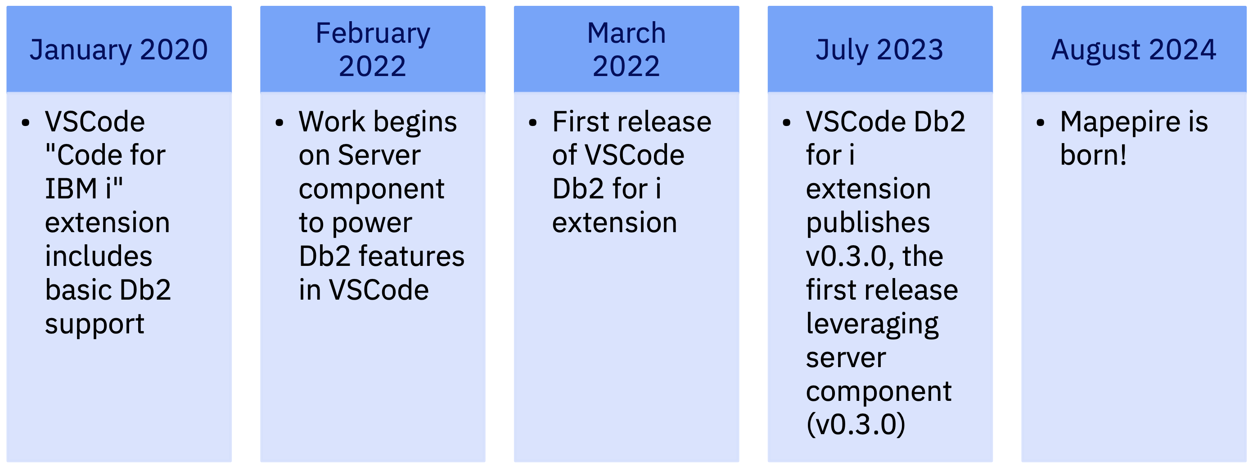
Mapepire Origin story...

Slide 10
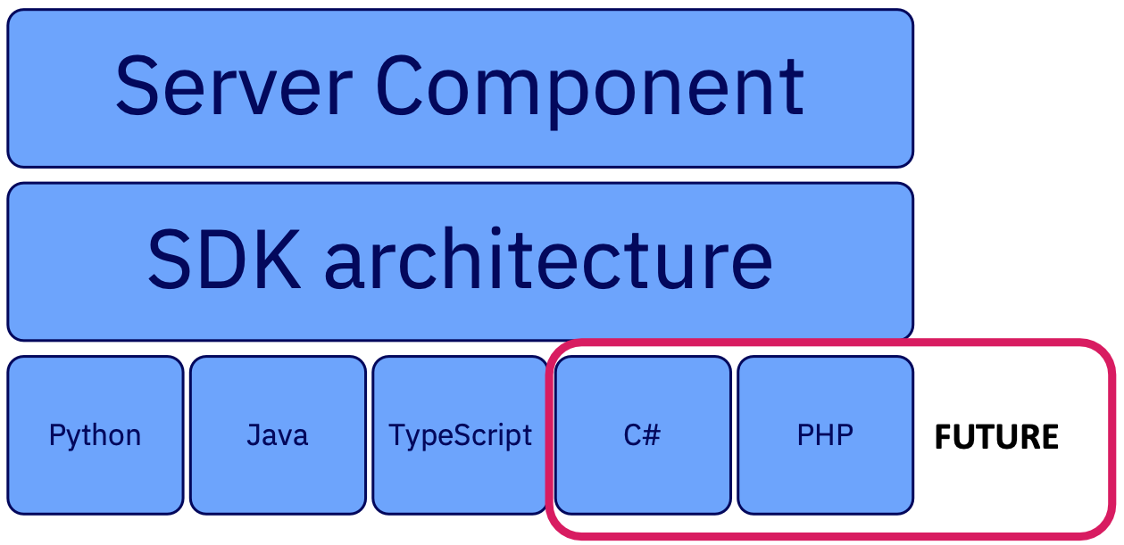
Mapepire Components

Slide 11
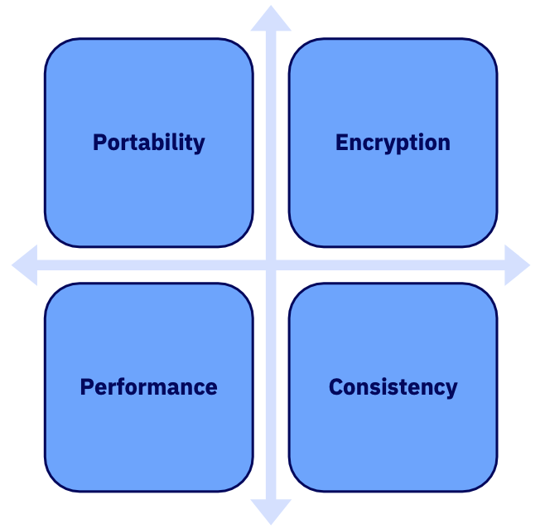
Core Tenets

Slide 12
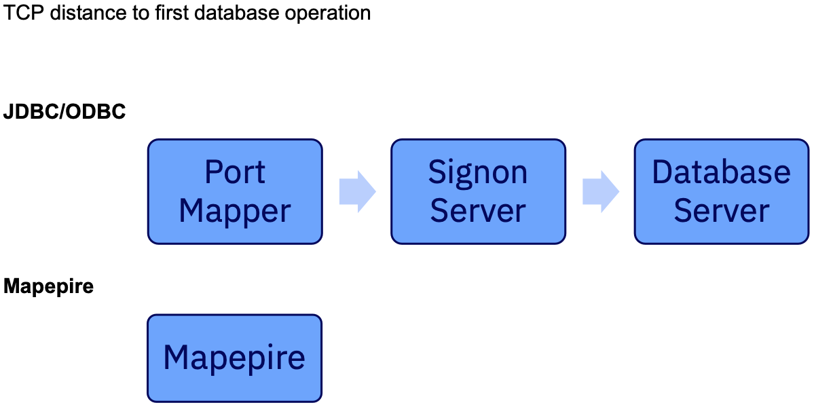
Single port? Big deal!

Slide 13
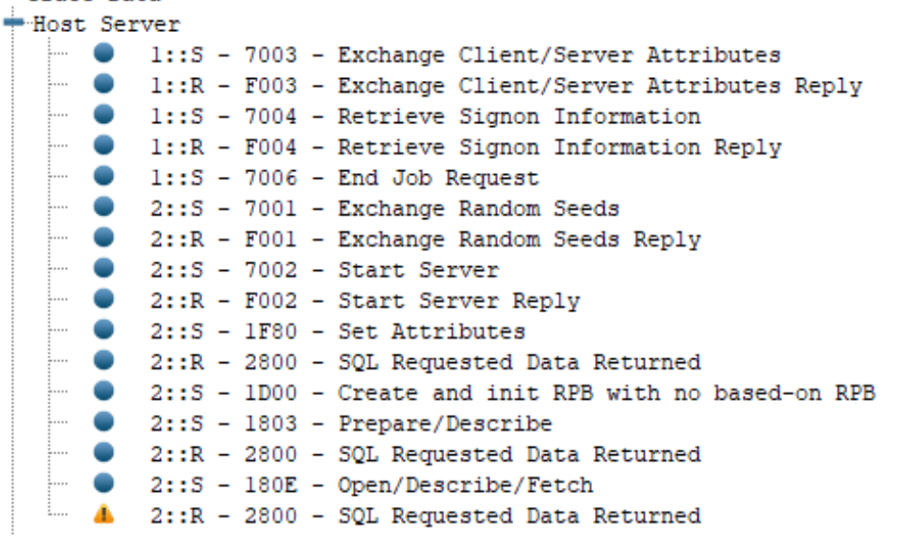
Distinct TCP Flows!!

Slide 14
How to encrypt data with _DBC
1. Log into DCM
2. Create a local certificate authority (CA) store
3. Create a local CA certificate
4. Record the value of the autocreated CA label
5. Create the *SYSTEM certificate store (if needed)
6. Create a new server certificate
7. Sign the server certificate with your local CA
8. Assign new server certificate to host server applications
9. Restart Host Servers
10. On client, download the server's certificate authority to a local truststore (or configure TLS to
ignore completely)

Slide 15
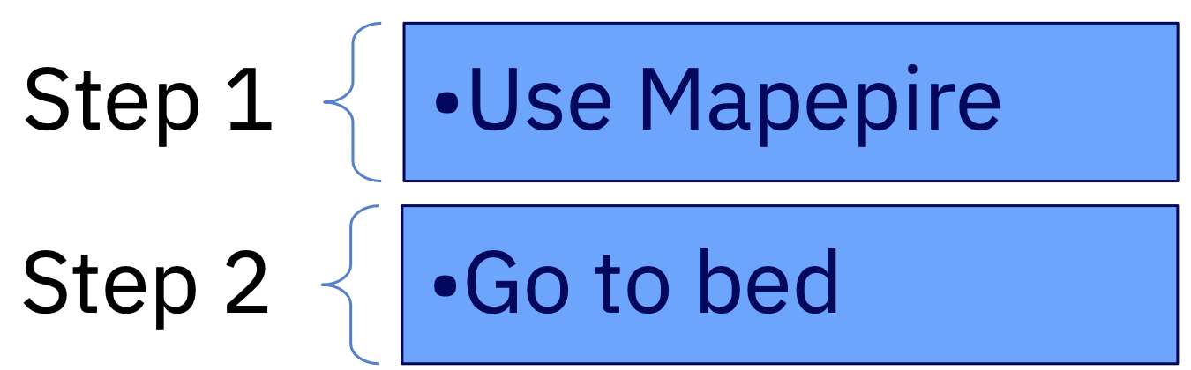
How to encrypt data with Mapepire

Slide 16
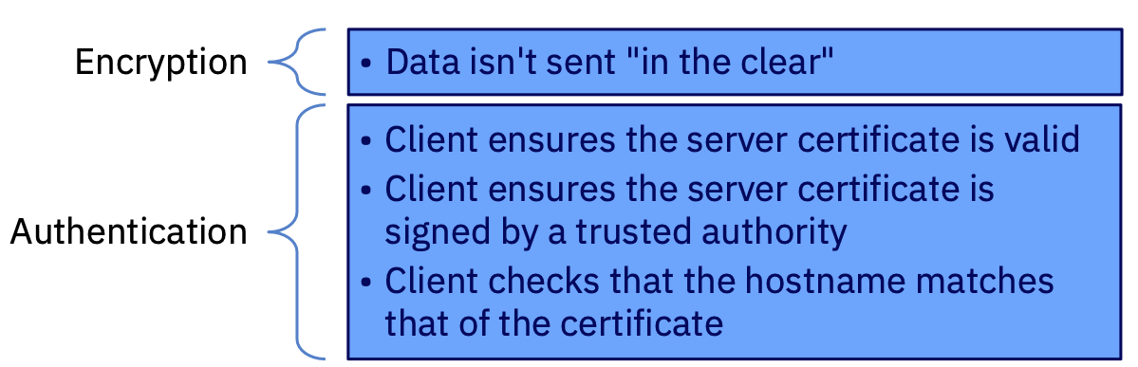
What does TLS provide?

Slide 17
How does Mapepire make it so easy?
• Admin has explicitly configured a certificate
• DCM has database server configured for TLS [future enhancement]
• LetsEncrypt certificates are present
• Autogenerate a self-signed certificate

Slide 18
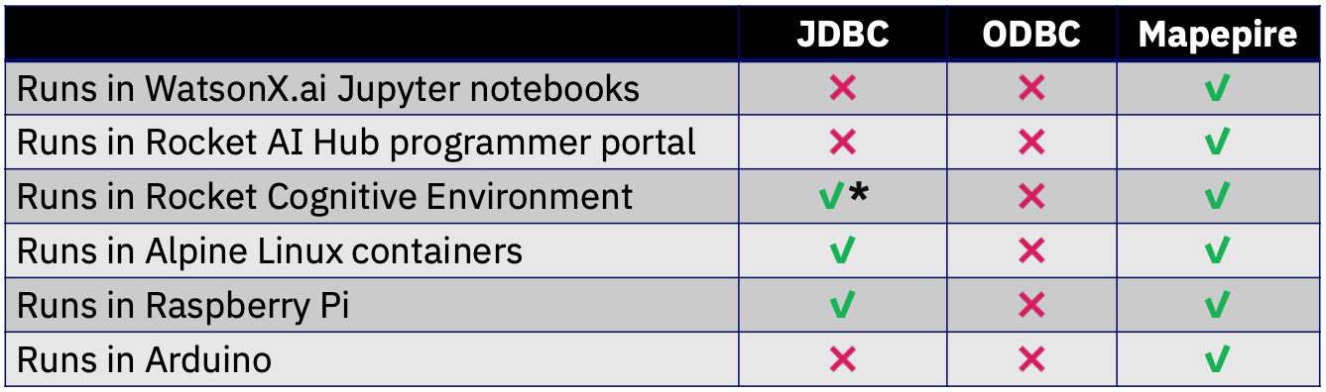
The biggest benefit of Mapepire.... Portability!!

Slide 19
Mapepire's back-end is JDBC
Mapepire is an interface in front of JTOpen and JDBC
Mapepire utilizes QZDASOINIT or, more likely, QZDASSINIT (S = "secure") jobs
All considerations for ODBC/JDBC server job scalability and security still apply

Slide 20

Security
Mapepire runs "locally" on your IBM i, which helps to control ODBC/JDBC connection sprawl
Object authority still applies
Any ODBC/JDBC exit points will still work to control traffic and access

Slide 21
How to manage the JDBC workload?
By default, all QZDASOINIT/ QZDASSINIT jobs run in QUSRWRK
Questions:
How to control out-of-control queries from query tools?
How to know which application is using up resources?
How to manage your JDBC jobs more effectively?
How to let critical users get the resources they need while not letting long queries take over the system?

Slide 22
Separate jobs by application, user, etc.
Learned the importance from Dawn May
Configure your QZDASSINIT jobs to run in separate subsystems, based on your criteria – E.g. JDBCSHOP, JDBCADHOC, JDBCNODE
Then performance "waits" can be aggregated by subsystem and you can configure memory, etc. Per subsystem
Also limit with these techniques https://www.ibm.com/support/pages/setting-limitations-resources-used-qzdasoinit-prestart-jobs
Additional benefit: JDBC jobs from different applications will not interact. Easier troubleshooting
Details: https://www.seidengroup.com/2022/05/04/simplify-with-subsystems/ Or contact us to discuss

Slide 23
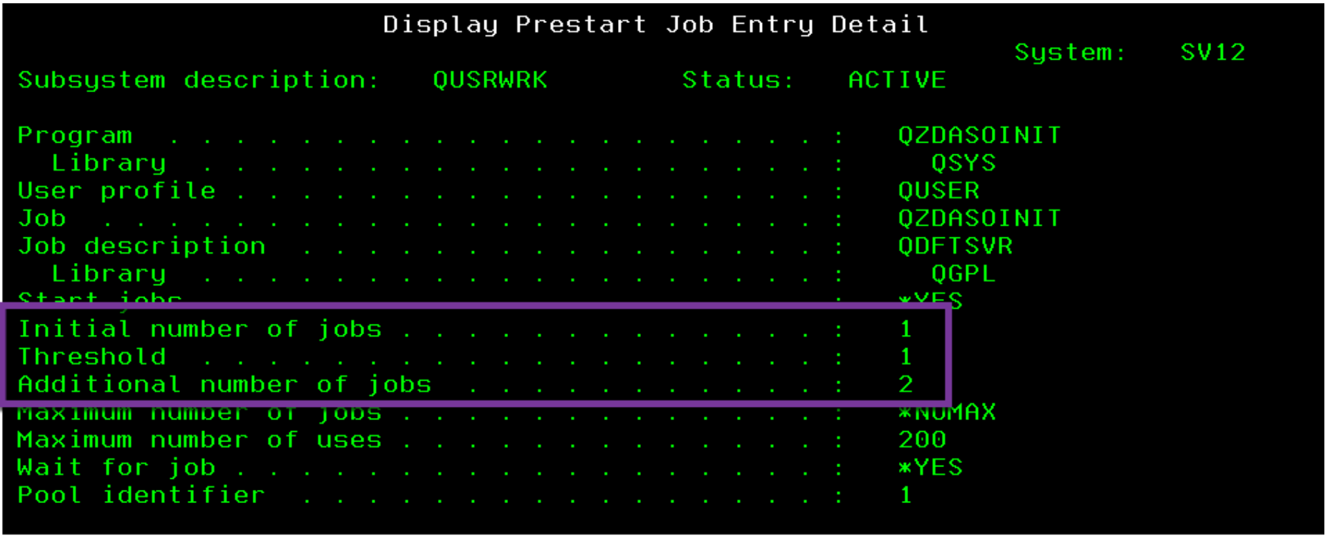
Configure JDBC Prestart jobs
Configure the right number of prestart jobs
– ODBC/JDBC prestart jobs are QZDASO(S)INIT in QUSRWRK
Check out your current configuration:
– DSPSBSD SBSD(qusrwrk)
– Choose 10, Prestart job entries
– Type 5 next to QZDASOINIT

Slide 24
Default ODBC/JDBC prestart job settings
Low defaults
Initial jobs = 1, threshold = 1, adljobs = 2
Change as needed:
CHGPJE SBSD(QSYS/QUSRWRK) PGM(QSYS/QZDASOINIT)
STRJOBS(*YES) INLJOBS(xx) THRESHOLD(xx)
ADLJOBS(xx)
How to determine optimal values? DSPACTPJ (coming up)

Slide 25
How many jobs are needed?
DSPACTPJ SBS(QUSRWRK) PGM(QZDASOINIT)
https://www.ibm.com/docs/en/i/7.4?topic=jobs-tuning-prestart-job-entries

Slide 26
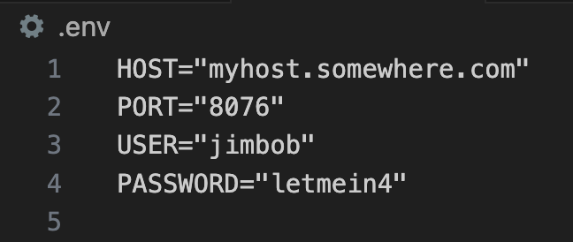
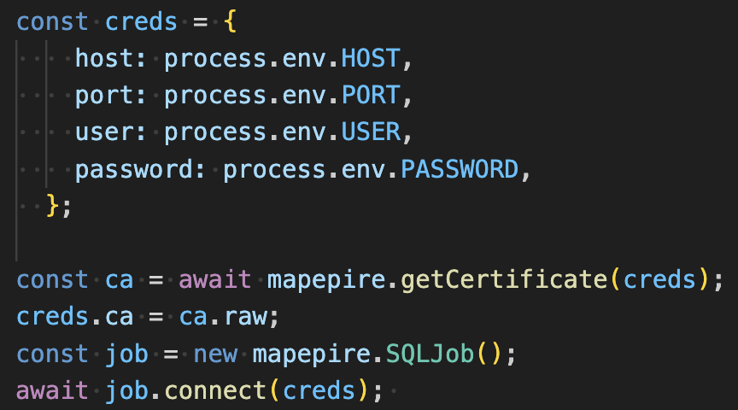
How to get started with Mapepire?
Install the mapepire client with npm install @ibm/mapepire-js
Create a .env file specifying HOST, USER, PASSWORD and PORT (this is the Mapepire server port)

Slide 27
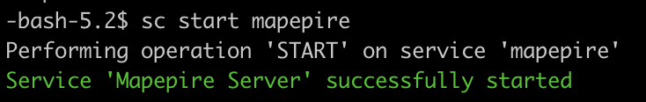
Launch the Mapepire server
Install the Mapepire server component `yum install mapepire-server
Install Service Commander `yum install service-commander`
Launch mapepire `sc start mapepire`

Slide 28

Now it’s time to write some queries!
Here is some of the functionality we have available to us
Connect to the database
Run CL commands
Run SQL commands
Run SQL commands as a batch
Run procedures
Explain a statement
Get server job
Get Mapepire version
Check liveliness
Set config
Get trace data
Close a connection

Slide 29
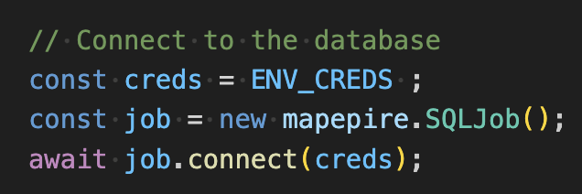
Connecting to the database
Use the connect method of the SQLJob class

Slide 30

Get the server certificate
Use the getCertificate method to retrieve the TLS certificate from the db2 server. If the server is using a self signed certificate, you can add it to your connection credentials to specify you trust this certificate.

Slide 31
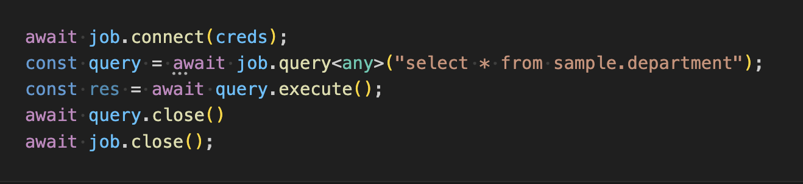
Executing a query
Use the query method of SQLJob to construct a query
Then call the queries execute method

Slide 32
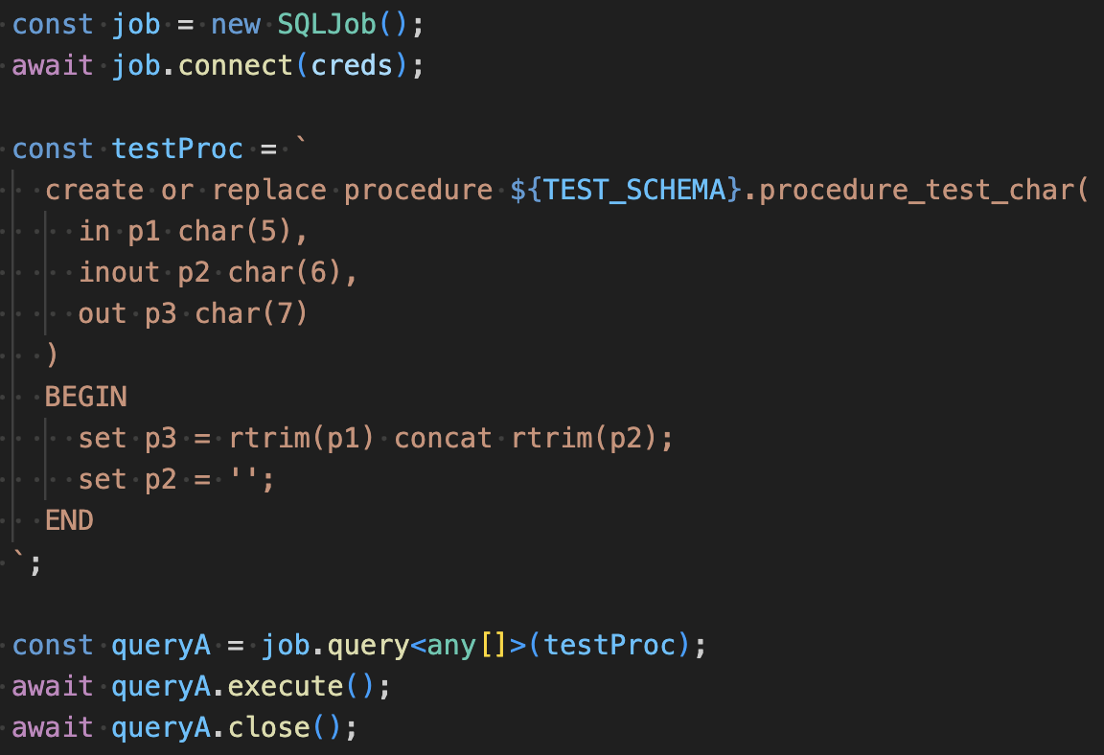
Executing a procedure
You can execute a procedure the same way that you would execute an SQL statement!

Slide 33
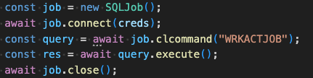
Executing a CL command
Use the CL method of the SQLJob class to execute CL commands

Slide 34
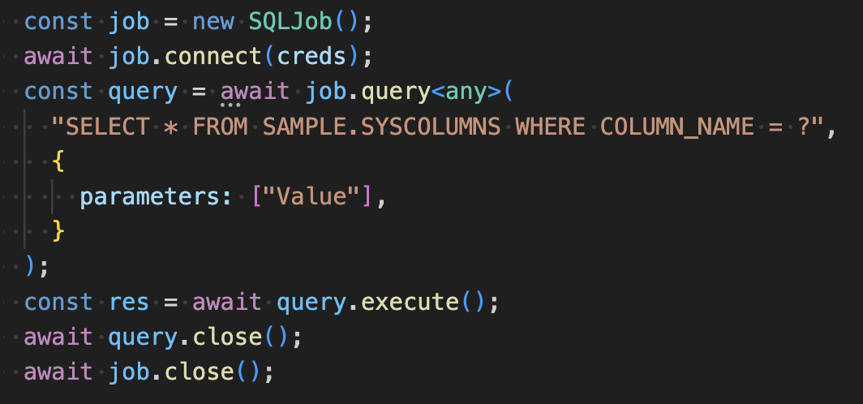
Executing a prepared statement
Use the query method of SQLJob to construct a query
Add the parameters for the prepared query
Then call the queries execute method

Slide 35

Explain an SQL statement
Use the explain method of SQLJob to explain an sql statement and return the result

Slide 36

Get Mapepire server version
Use the getVersion method of SQLJob to retrieve the Mapepire server version

Slide 37

Retrieve the count of pending transactions
Use the getPendingTransactions method of SQLJob to retrieve the count of pending transactions

Slide 38

Retrieve the number of ongoing requests for a job
Use the getRunningCount method of SQLJob to retrieve the number of ongoing requests for the job

Slide 39

Retrieve the status for the job
Use the getStatus method of SQLJob to retrieve the status of the job
Can be any of notStarted, connecting, ready, busy, ended

Slide 40

Retrieve the trace file path
Use the getTraceFilePath method of SQLJob to retrieve the file path of the trace file

Slide 41

Get the server trace data
Use the getTraceData method of SQLJob to retrieve the trace data from the backend

Slide 42
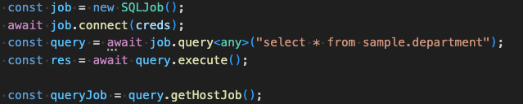
Get the SQLJob that is running the query
Use the getHostJob method of Query class to return the SQLJob that is running the query

Slide 43
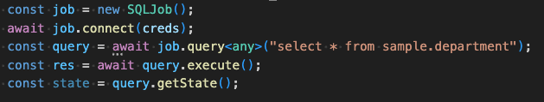
Get the state of the query
Use the getState method of Query class to return the state of the query
Can be one of "NOT_YET_RUN", "RUN_MORE_DATA_AVAILABLE", "RUN_DONE", "ERROR"

Slide 44
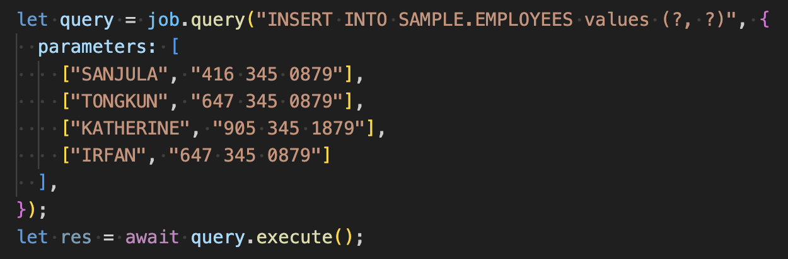
Executing a batch of statements
Use the query method of SQLJob to construct a prepared statement
Use a 2d array of parameters to ensure the query is constructed as a batch operation
Then call the queries execute method

Slide 45
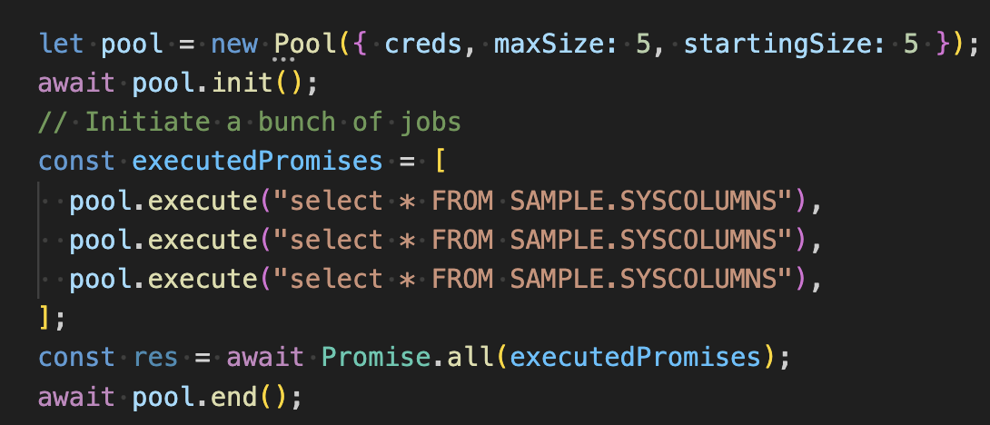
Executing statements using a pool
Initialize a new pool object
Call the pool’s execute method to run a query using any free job
Call the pool’s end method to destroy the pool and cleanup resources

Slide 46

Set the backend log level
Use the setTraceConfig method of the SQLJob class to set the trace level and destination for the Mapepire server
In this case we are sending the trace data to a file, and we are using the most verbose level of logging

Slide 47
Questions?
Please ask any burning questions you may have!

Slide 48

Forget ODBC! Here’s a New Db2 Connector - Jonathan Zak and Sanjula Ganepola
Please take the last minute of this session to complete the evaluation. A direct link to the evaluation can be found using the QR code below.

Slide 49

For More Information:
Links You Need | Twitter | #Hashtags
IBM i Home Page: https://www.ibm.com/it-infrastructure/power/os/ibm-i (find link to Forrester Study and updated IBM i Strategy Whitepaper) IBM Strategy Whitepaper: https://www.ibm.com/it-infrastructure/us-en/resources/power/i-strategy-roadmap/ IBM Client Success: https://www.ibm.com/it-infrastructure/us-en/resources/power/ibm-i-customer-stories/ Support Life Cycle: https://www.ibm.com/support/lifecycle/ License Topics: https://www-01.ibm.com/support/docview.wss?uid=nas8N1022087 HelpSystems 2021 Marketplace Survey https://www.helpsystems.com/resources/guides/ibm-i-marketplace-survey-results | @IBMSystems @COMMONug @IBMChampions @IBMSystemsISVs @IBMiMag @ITJungleNews @SAPonIBMi @SiDforIBMi | #PowerSystems #IBMi #IBMAIX #POWER9 #LinuxonPower #OpenPOWER #HANAonPower #ITinfrastructure #OpenSource #HybridCloud #BigData

Slide 50
Special notices
This document was developed for IBM offerings in the United States as of the date of publication. IBM may not make these offerings available in other countries, and the information is subject to change without notice. Consult your local IBM business contact for information on the IBM offerings available in your area.
Information in this document concerning non-IBM products was obtained from the suppliers of these products or other public sources. Questions on the capabilities of non-IBM products should be addressed to the suppliers of those products.
IBM may have patents or pending patent applications covering subject matter in this document. The furnishing of this document does not give you any license to these patents. Send license inquires, in writing, to IBM Director of Licensing, IBM Corporation, New Castle Drive, Armonk, NY 10504-1785 USA.
All statements regarding IBM future direction and intent are subject to change or withdrawal without notice, and represent goals and objectives only.
The information contained in this document has not been submitted to any formal IBM test and is provided "AS IS" with no warranties or guarantees either expressed or implied.
All examples cited or described in this document are presented as illustrations of the manner in which some IBM products can be used and the results that may be achieved. Actual environmental costs and performance characteristics will vary depending on individual client configurations and conditions.
IBM Global Financing offerings are provided through IBM Credit Corporation in the United States and other IBM subsidiaries and divisions worldwide to qualified commercial and government clients. Rates are based on a client's credit rating, financing terms, offering type, equipment type and options, and may vary by country. Other restrictions may apply. Rates and offerings are subject to change, extension or withdrawal without notice.
IBM is not responsible for printing errors in this document that result in pricing or information inaccuracies.
All prices shown are IBM's United States suggested list prices and are subject to change without notice; reseller prices may vary.
IBM hardware products are manufactured from new parts, or new and serviceable used parts. Regardless, our warranty terms apply.
Any performance data contained in this document was determined in a controlled environment. Actual results may vary significantly and are dependent on many factors including system hardware configuration and software design and configuration. Some measurements quoted in this document may have been made on development-level systems. There is no guarantee these measurements will be the same on generally-available systems. Some measurements quoted in this document may have been estimated through extrapolation. Users of this document should verify the applicable data for their specific environment.
Revised September 26, 2006

Slide 51
Special notices (cont.)
IBM, the IBM logo, ibm.com AIX, AIX (logo), AIX 5L, AIX 6 (logo), AS/400, BladeCenter, Blue Gene, ClusterProven, Db2, ESCON, i5/OS, i5/OS (logo), IBM Business Partner (logo), IntelliStation, LoadLeveler, Lotus, Lotus Notes, Notes, Operating System/400, OS/400, PartnerLink, PartnerWorld, PowerPC, pSeries, Rational, RISC System/6000, RS/6000, THINK, Tivoli, Tivoli (logo), Tivoli Management Environment, WebSphere, xSeries, z/OS, zSeries, Active Memory, Balanced Warehouse, CacheFlow, Cool Blue, IBM Systems Director VMControl, pureScale, TurboCore, Chiphopper, Cloudscape, Db2 Universal Database, DS4000, DS6000, DS8000, EnergyScale, Enterprise Workload Manager, General Parallel File System, , GPFS, HACMP, HACMP/6000, HASM, IBM Systems Director Active Energy Manager, iSeries, Micro-Partitioning, POWER, PowerExecutive, PowerVM, PowerVM (logo), PowerHA, Power Architecture, Power Everywhere, Power Family, POWER Hypervisor, Power Systems, Power Systems (logo), Power Systems Software, Power Systems Software (logo), POWER2, POWER3, POWER4, POWER4+, POWER5, POWER5+, POWER6, POWER6+, POWER7, System i, System p, System p5, System Storage, System z, TME 10, Workload Partitions Manager and X-Architecture are trademarks or registered trademarks of International Business Machines Corporation in the United States, other countries, or both. If these and other IBM trademarked terms are marked on their first occurrence in this information with a trademark symbol (® or ™), these symbols indicate U.S. registered or common law trademarks owned by IBM at the time this information was published. Such trademarks may also be registered or common law trademarks in other countries.
A full list of U.S. trademarks owned by IBM may be found at: http://www.ibm.com/legal/copytrade.shtml.
Adobe, the Adobe logo, PostScript, and the PostScript logo are either registered trademarks or trademarks of Adobe Systems Incorporated in the United States, and/or other countries.
AltiVec is a trademark of Freescale Semiconductor, Inc.
AMD Opteron is a trademark of Advanced Micro Devices, Inc.
InfiniBand, InfiniBand Trade Association and the InfiniBand design marks are trademarks and/or service marks of the InfiniBand Trade Association.
Intel, Intel logo, Intel Inside, Intel Inside logo, Intel Centrino, Intel Centrino logo, Celeron, Intel Xeon, Intel SpeedStep, Itanium, and Pentium are trademarks or registered trademarks of Intel Corporation or its subsidiaries in the United States and other countries.
IT Infrastructure Library is a registered trademark of the Central Computer and Telecommunications Agency which is now part of the Office of Government Commerce.
Java and all Java-based trademarks and logos are trademarks or registered trademarks of Oracle and/or its affiliates.
Linear Tape-Open, LTO, the LTO Logo, Ultrium, and the Ultrium logo are trademarks of HP, IBM Corp. and Quantum in the U.S. and other countries.
Linux is a registered trademark of Linus Torvalds in the United States, other countries or both.
Microsoft, Windows and the Windows logo are registered trademarks of Microsoft Corporation in the United States, other countries or both.
NetBench is a registered trademark of Ziff Davis Media in the United States, other countries or both.
SPECint, SPECfp, SPECjbb, SPECweb, SPECjAppServer, SPEC OMP, SPECviewperf, SPECapc, SPEChpc, SPECjvm, SPECmail, SPECimap and SPECsfs are trademarks of the Standard Performance Evaluation Corp (SPEC).
The Power Architecture and Power.org wordmarks and the Power and Power.org logos and related marks are trademarks and service marks licensed by Power.org.
TPC-C and TPC-H are trademarks of the Transaction Performance Processing Council (TPPC).
UNIX is a registered trademark of The Open Group in the United States, other countries or both.
Other company, product and service names may be trademarks or service marks of others.
Revised December 2, 2010

